Slide 1


An Introduction to
Homomorphic Encryption
for Computational Linguists
@PrivateNLP

Slide 2
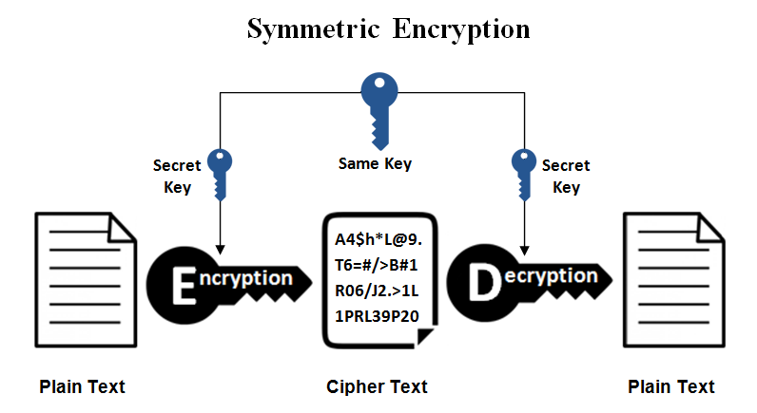
Symmetric Encryption (like AES)
Image source: https://www.ssl2buy.com/wiki/symmetric-vs-asymmetric-encryption-what-are-differences
@PrivateNLP

Slide 3
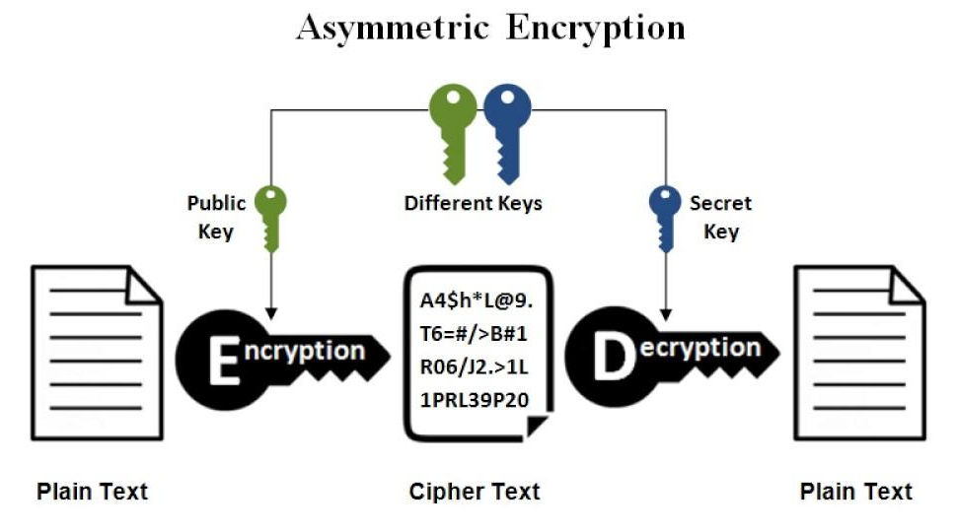
Asymmetric Encryption (like RSA)
Image source: https://www.ssl2buy.com/wiki/symmetric-vs-asymmetric-encryption-what-are-differences
@PrivateNLP

Slide 4
The Looming Risk
Cryptographic Schemes are based on hard problems
RSA is based on the hard problem of large prime factorization
Can be broken by Shor’s algorithm using quantum computers
@PrivateNLP

Slide 5
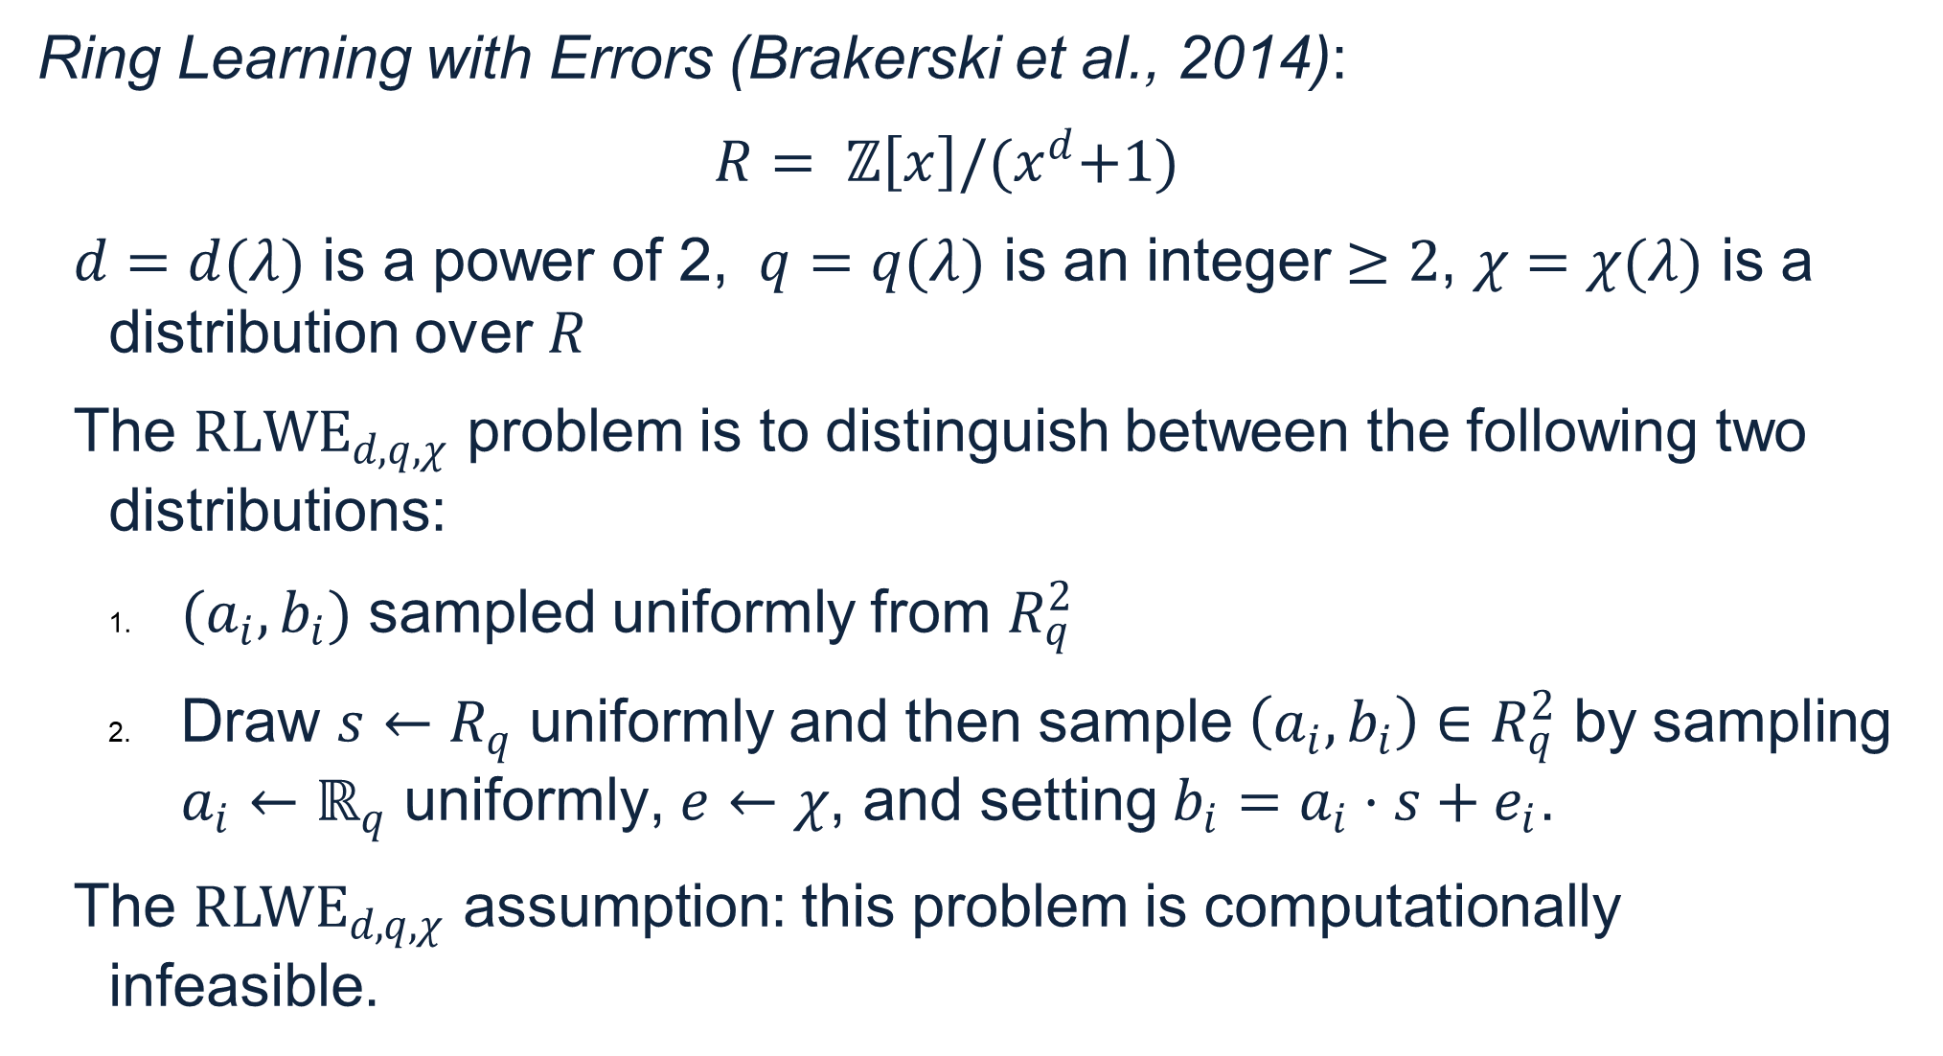
Ring Learning With Errors
@PrivateNLP

Slide 6
Lattice-Based Cryptography
b1
b2
@PrivateNLP

Slide 7











Homomorphic Encryption
Data owner
Service provider
@PrivateNLP

Slide 8
Benefits
Send expensive computations to the cloud
Limit communication costs
Not have to depend on network availability
Have input and output data privacy
Have mathematically guaranteed post-quantum security
@PrivateNLP

Slide 9
Component-Wise Operations
Addition | Multiplication
0x⁴ + 4x³ + 6x² + 2x + 5 + 1x⁴ + 6x³ + 3x² + 5x + 2 1x⁴ + 10x³ + 9x² +7x + 7 | 0x⁴ + 4x³ + 6x² + 2x + 5 * 1x⁴ + 6x³ + 3x² + 5x + 2 1x⁴ + 24x³ + 18x² +10x + 10
@PrivateNLP

Slide 10
Polynomial Operations
Addition | Multiplication
0x⁴ + 4x³ + 6x² + 2x + 5 + 1x⁴ + 6x³ + 3x² + 5x + 2 1x⁴ + 10x³ + 9x² +7x + 7 | 0x⁴ + 4x³ + 6x² + 2x + 5 * 1x⁴ + 6x³ + 3x² + 5x + 2 4x⁷+30x⁶+50x⁵+55x⁴+74x³+37x²+29x+10
@PrivateNLP

Slide 11

What You Can Do
What You Can’t Do
v
Addition: easy & cheap
Multiplication: easy & expensive
Plaintext & Ciphertext
Ciphertext & Ciphertext
Non-polynomial operations
Most schemes: floating point operations
@PrivateNLP

Slide 12
Dealing with Non-Polynomial Operations
f(x) = x^2 used as an activation function instead of ReLU (Gilad-Bachrach et al., 2016)
Polynomial approximation of sigmoid function using Chebyshev Polynomials or other such approximations (examples in multiple papers by Ehsan Hesamifard)
Approximation using lookup table (Thaine, Gorbunov, and Penn, 2019)
@PrivateNLP

Slide 13
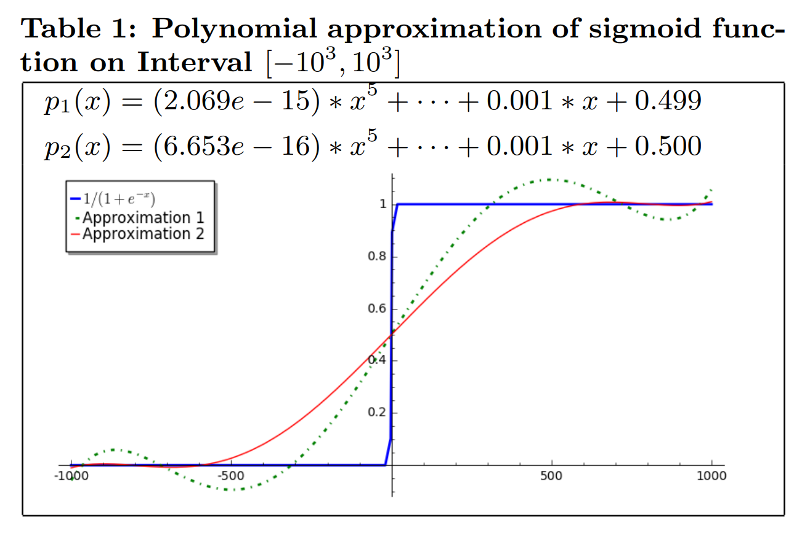
Example Approximation
(Hesamifard et. al 2016/2017)
@PrivateNLP

Slide 14
Floating Point Operations
Option 1 (BGV & BFV schemes):
Decide precision n, multiple by 10^n and round or truncate
Option 2 (CKKS scheme):
Floating point operations possible
@PrivateNLP

Slide 15
Some NLP-Specific Applications of Homomorphic Encryption
Secure spoken language processing proposed:
Secure spoken keyword recognition (using HMMs) [Pathak et al., 2011]
Secure speaker identification (using GMMs) [Pathak et al., 2013]
Secure speaker authentication (using GMMs) [Pathak et al., 2013]
Secure Fourier transform and speech feature extraction [Thaine and Penn, 2019]
Secure text processing proposed:
Secure TF-IDF (Patent)
Secure Language Recognition (Patent)
Secure Keyword Search (Patent)
Privacy-Preserving Character Language Modelling [Thaine and Penn, 2019]
@PrivateNLP

Slide 16
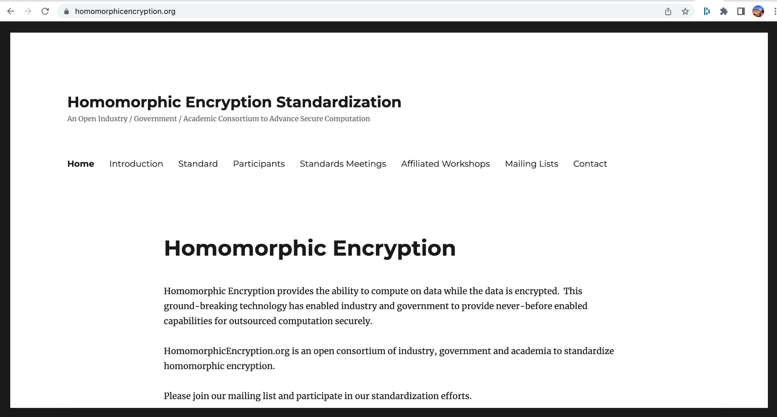
@PrivateNLP

Slide 17
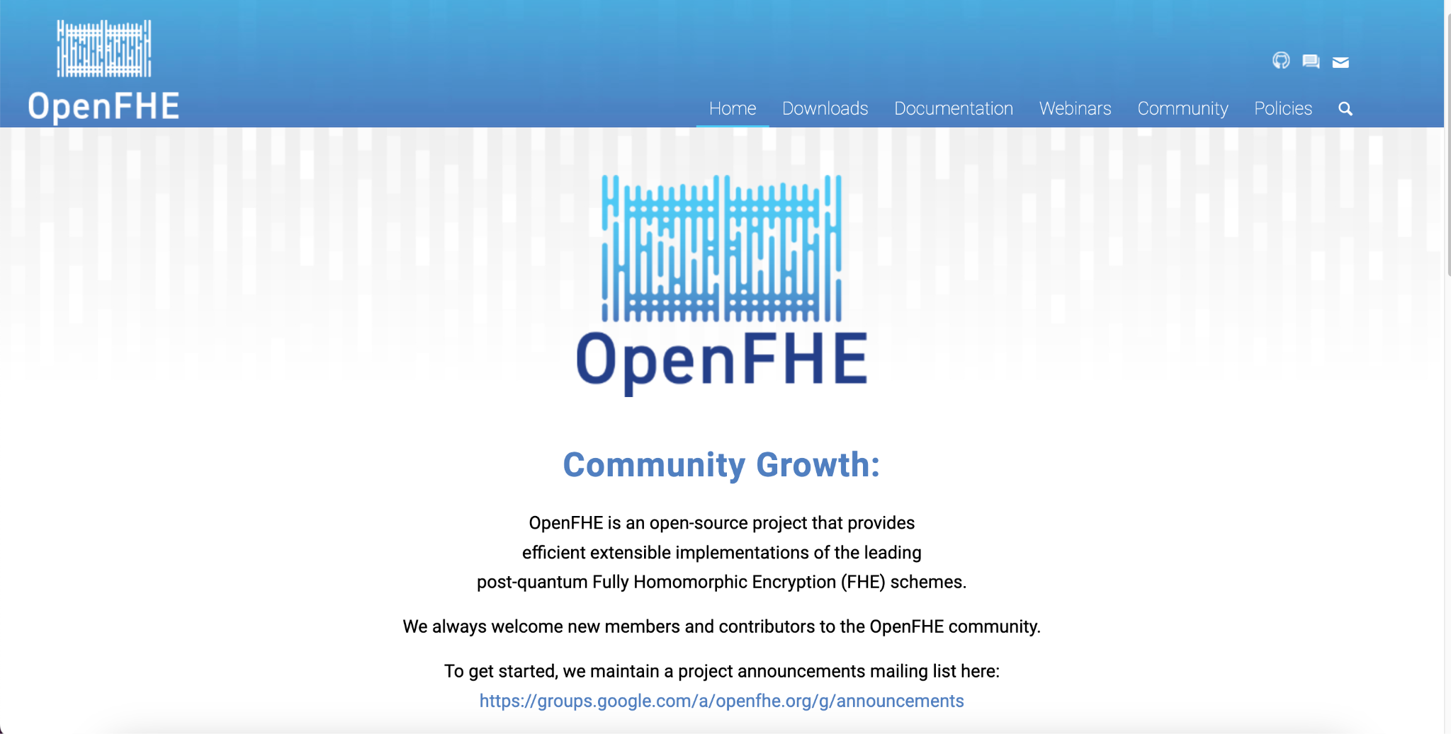
@PrivateNLP

Slide 18
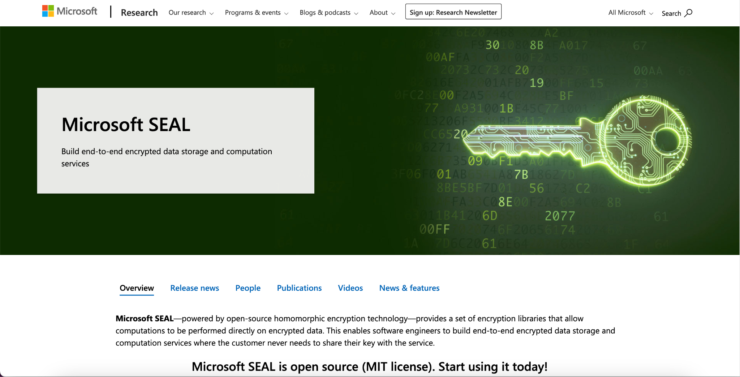
@PrivateNLP

Slide 19
Task:
Which Computational Linguistics tasks would you use Homomorphic Encryption for & how?
@PrivateNLP

Slide 20






Thank You!
patricia@private-ai.com
@PrivateNLP
www.private-ai.com

